Slide 1
Uber Pickups in New York City

Slide 2
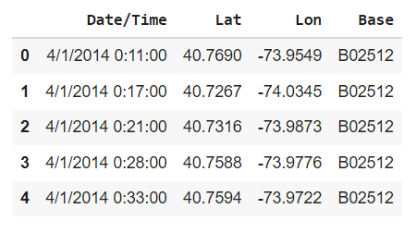
Introduction
The dataset has an information of 4.5 million uber pickups in New York City from April 2014 to September 2014 and 14 million more from January 2015 to June 2015.
Objective:
To analyse data and to plot visualizations to help uber in improving business insights.
Data/Methodology:
There are four different group of files. Those are:
Uber trip data from 2014 (April - September), separated by month.
Uber trip data from 2015 (January - June)
non-Uber FHV (For-Hire Vehicle) trips.
Aggregate ride and vehicle statistics for all FHV companies.
All the files were merged together to draw better insights for uber. Fig (1) shows a snapshot of uber 2014 data merged together for months April - September.
Fig 1: Snapshot of uber 2014 data

Slide 3
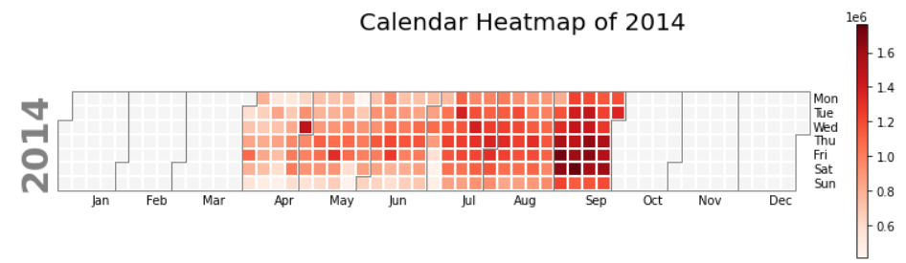
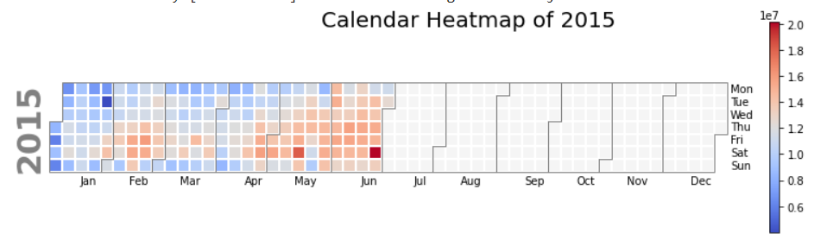
The calendar heatmap of 2014 and 2015 shows the number of days in which maximum number of pickups were done in different months of 2014 and 2015.
In 2014, the maximum number of pickups were in the month of september and in 2015 the maximum number of uber pickups were in the month of June.

Slide 4
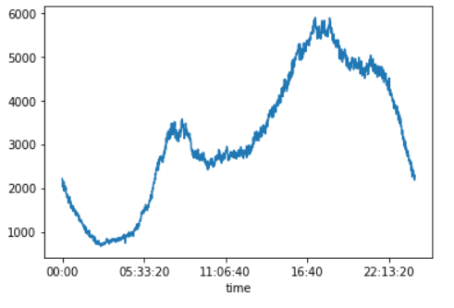
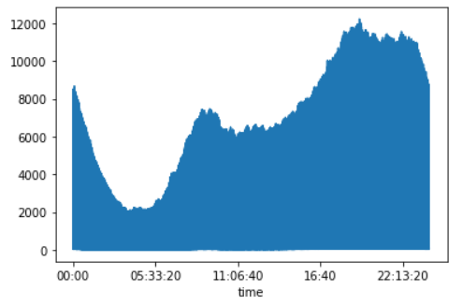
Visualization of Uber pickups at different time in 2014
Time at which most pickups were done in 2014
Time at which most pickups were done in 2015
The x-axis shows time and y-axis shows the counts at different time. The time gap on x-axis is at a gap of 5 hours and 33 minutes.
From the line chart of 2014, it can be observed that during 9:00 a.m. and 10:00 a.m. uber pickups were high. But during evening after 5:00 p.m. there is a sudden increase in the uber pickups which is also much larger than the morning time.
From the line chart of 2015, the maximum number of uber pickups were around 7:00 p.m.

Slide 5
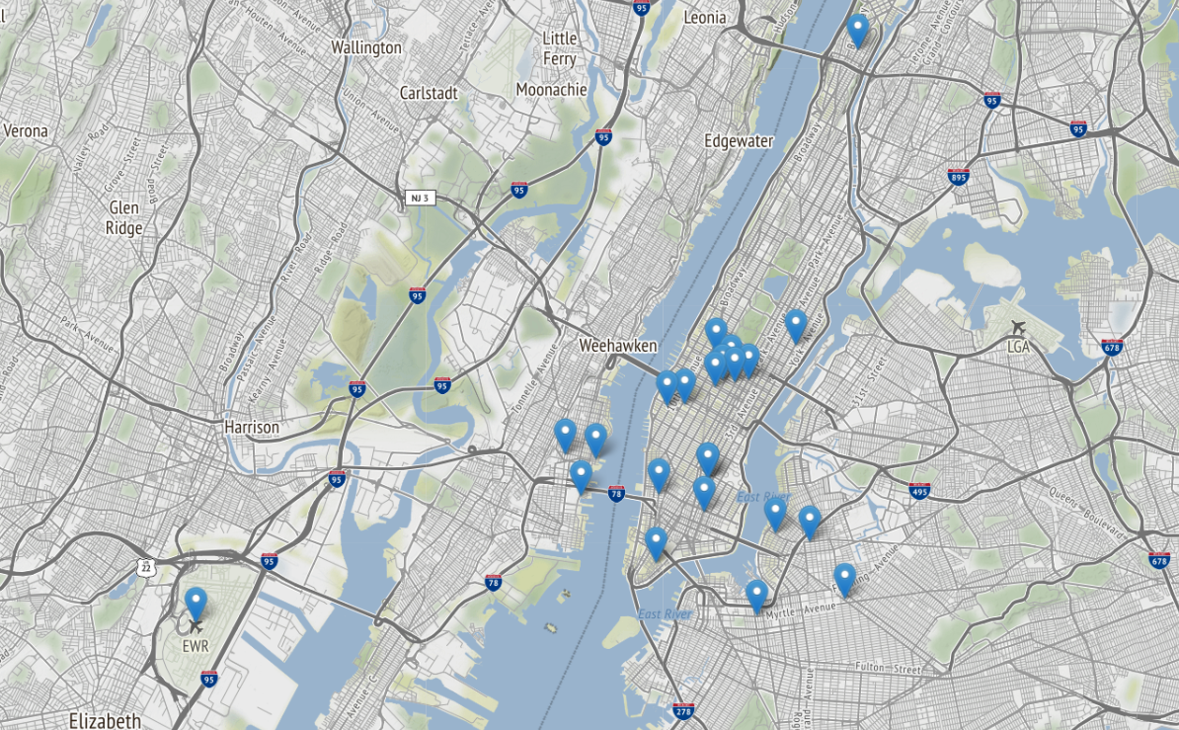
Different Uber Pickup Location in 2014
The map displays some of the Uber pickup location in New York City. These locations are identified with the help of latitude and longitude.
From the map, it can be observed that most of the pickup locations are around Weehawken and some of the pickup location is from EWR Airport.

Slide 6
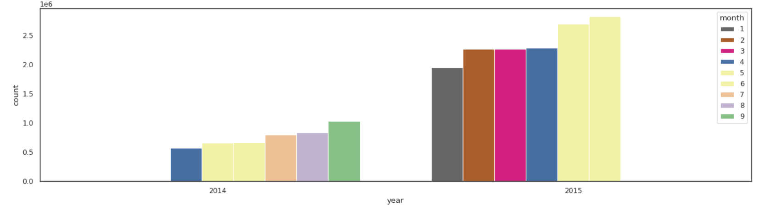
Comparison of Uber pickups in 2014 and 2015
From the bar chart, it can be observed that the uber pickups were more in year 2015 as compared to 2014.
From the data available, the following months are in common between 2014 and 2015: April, May, June, July.
From these common months, 2015 have more pickups than 2014.

Slide 7
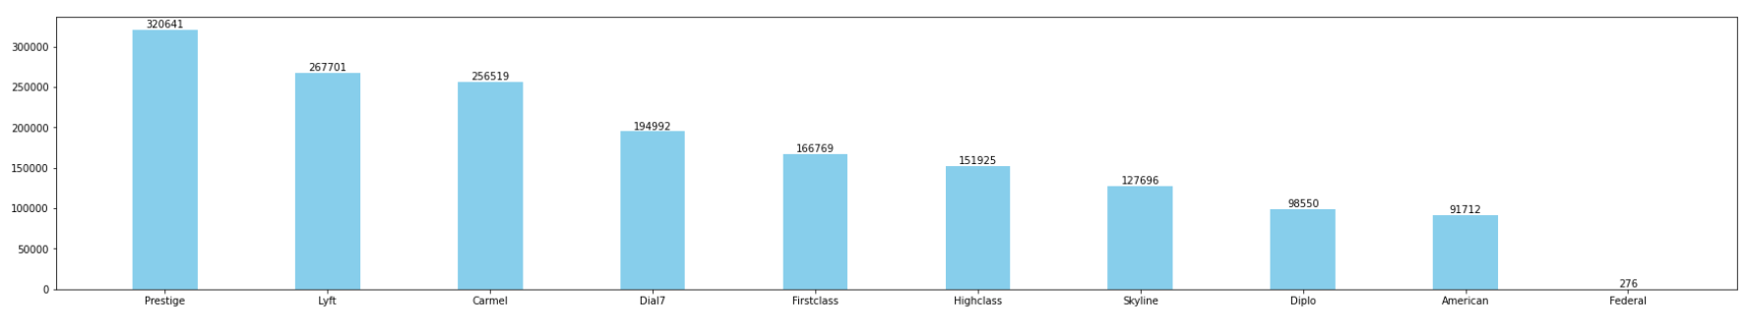
Non - Uber FHV Trips
Large number of FHV trips were observed by Prestige during 2014 in the months of July, August and September.

Slide 8
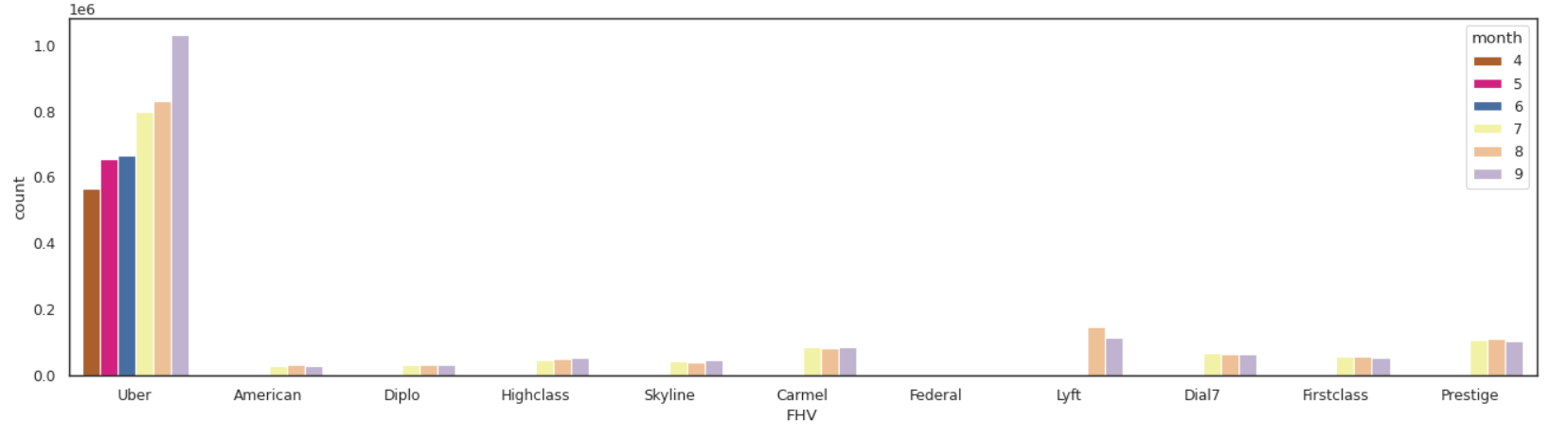
Comparing Uber pickups with other FHV Companies
Uber has large number of pickups as compared to other FHV Companies.

Slide 9
Recommendations
Uber should increase its availability during the evening from different dispatching base mainly from Danach NY and Weiter.
Recommendations
Uber should increase availability near the Weehawken township as their are more pickups
Uber should be cautious about the two high leading companies: Prestige and Lyft as they have high number of pickups in 2014
Solution: Uber should reduce its fair price near Weehawken township, as there are large number of pickups in that particular location. Also, uber should increase its price near airports to raise profit as people in hurry will not be much concerned about the fair price.

Slide 10
Thank You!

